Slide 1

Roots of Anti-Fascist, Anti-Racist, Labor Support Organizing in the 1930s and 1940s
Mike Goldfield

Slide 2
My Background, a bit

Slide 3
Students At City College,1934
October 1934 protest against Italian Ambassador Augusto Rosso at City College of New York.
Rosso had been invited to speak at CCNY as an official representative of Benito Mussolini's fascist regime. Many students, objected strongly to giving a platform to a representative of a dictatorship that had destroyed labor unions, imprisoned political opponents, and suppressed academic freedom in Italy.
When Rosso arrived on campus, hundreds of students demonstrated against his appearance. The demonstrations became so disruptive that college authorities and police intervened. The event attracted considerable attention in the New York press and became a symbol of growing anti-fascist sentiment among students.

Slide 4
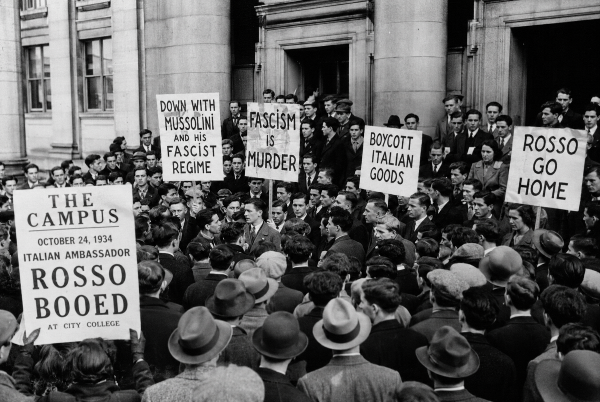

Slide 5
Hands Off Ethiopia, 1935
The Italian invasion of Ethiopia in 1935 . Ethiopia was one of the few independent African states and a powerful symbol for Black people worldwide.
On August 3, 1935, 25,000 Black and white demonstrators marched in Harlem against Mussolini's threatened invasion. The demonstration brought together Black labor groups, Pan-Africanists, religious organizations, Italian anti-fascists, and left-wing organizations.
The "Hands Off Ethiopia" movement became a major expression of Black anti-fascism. Many African Americans viewed the Ethiopian struggle as part of a global fight against white supremacy, colonialism, and fascism.
Important figures associated with Ethiopia solidarity included: W. E. B. Du Bois, Paul Robeson, C. L. R. James, George Padmore, A. Philip Randolph, Langston Hughes
For many Black radicals, Ethiopia was the issue that fused anti-racism, anti-colonialism, and anti-fascism into a single political outlook.

Slide 6
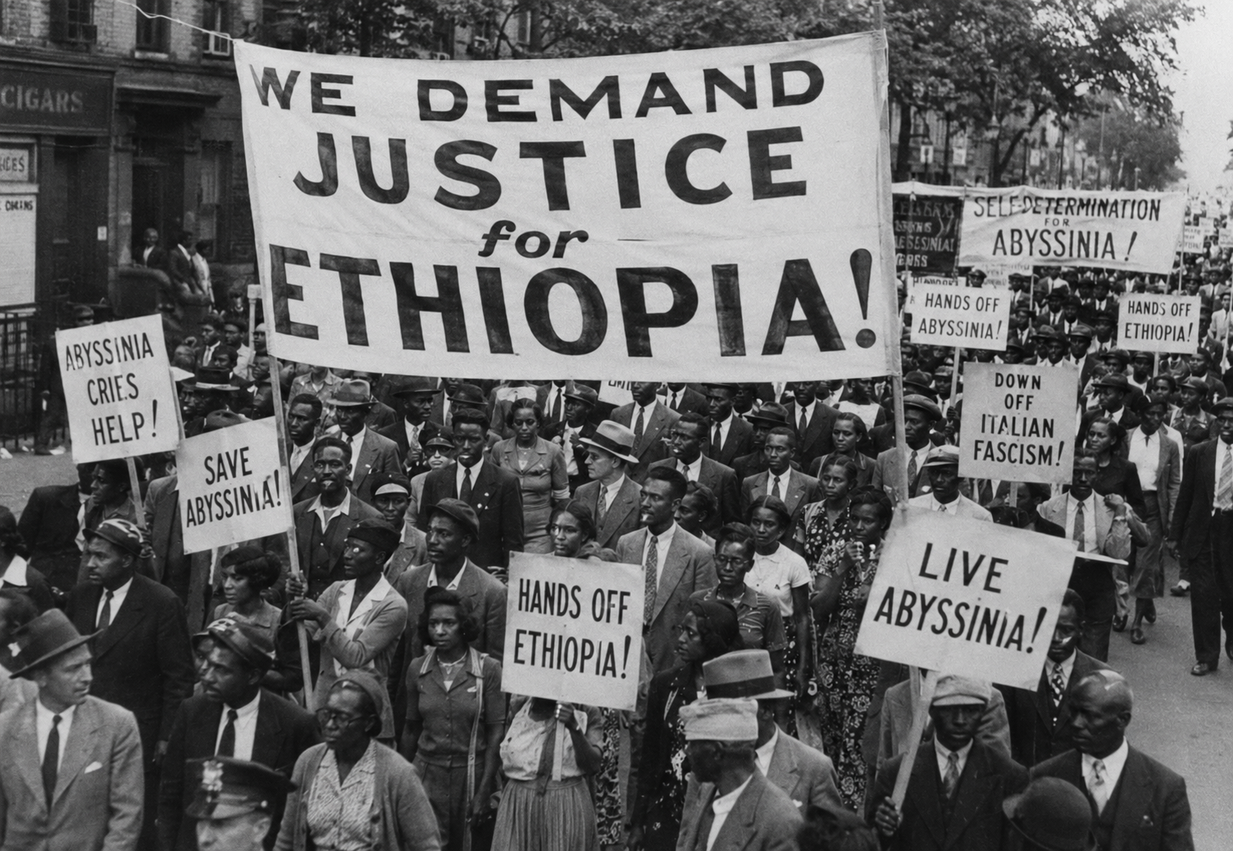

Slide 7
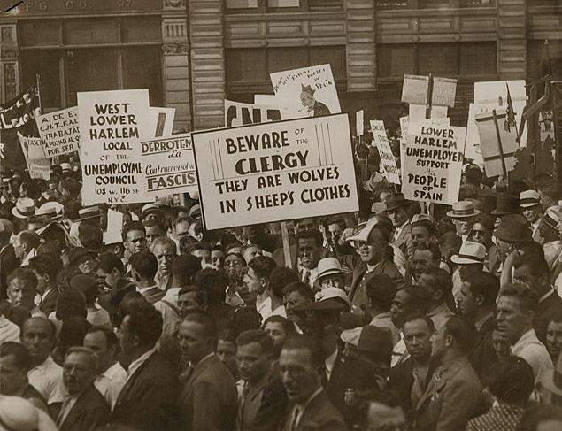
Spain, Union Square

Slide 8
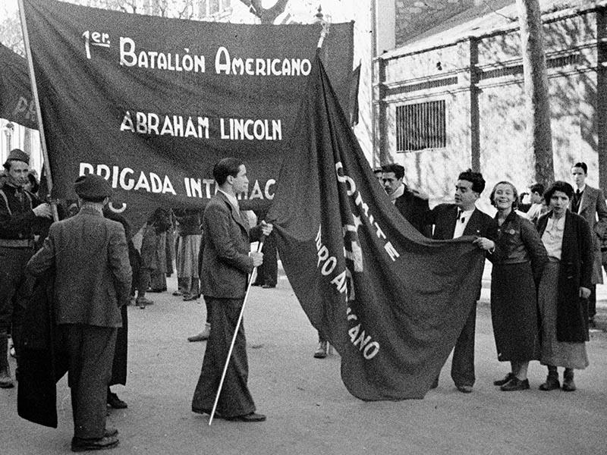
Abraham Lincoln Brigade

Slide 9
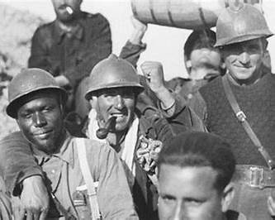

Slide 10
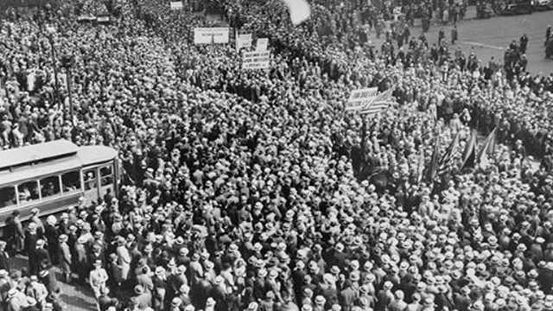
Rallies in Support of Spain with 10s of Thousands of Demonstrators

Slide 11
Parallel Development of Labor Movement

Slide 12
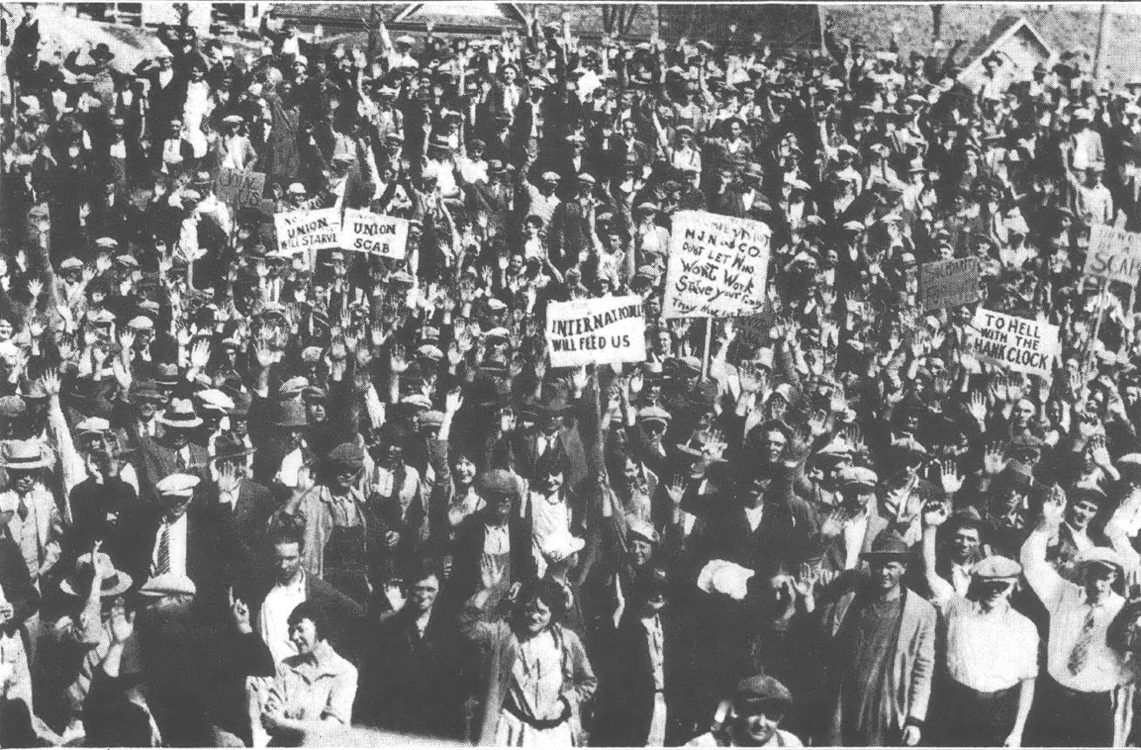
Gastonia, NC 1929

Slide 13
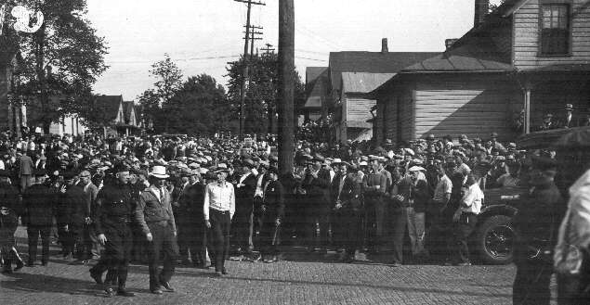
Toledo Auto lite, 1934

Slide 14
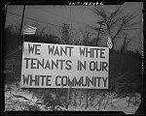
Sojourner Truth Homes, Detroit,1942

Slide 15
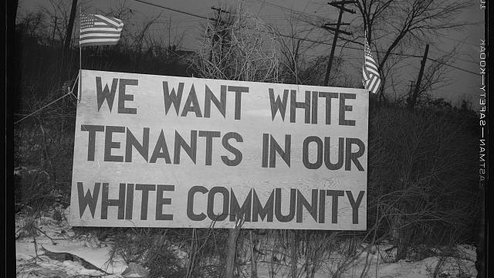

Slide 16
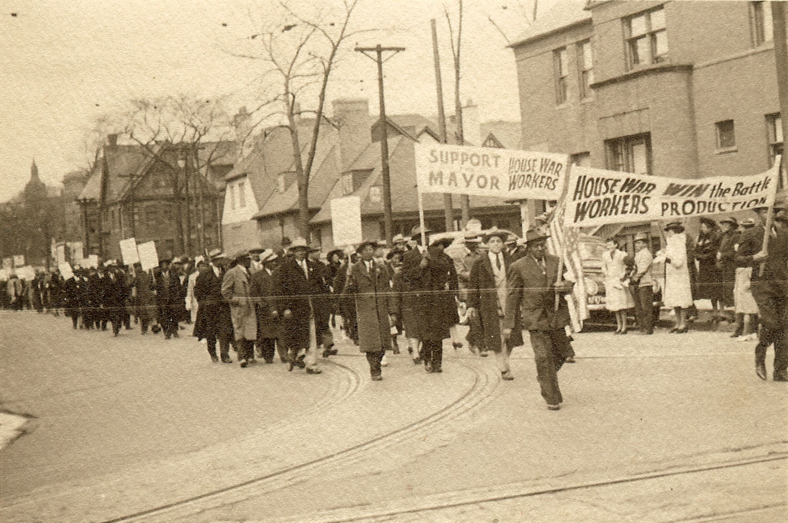

Slide 17


Slide 18
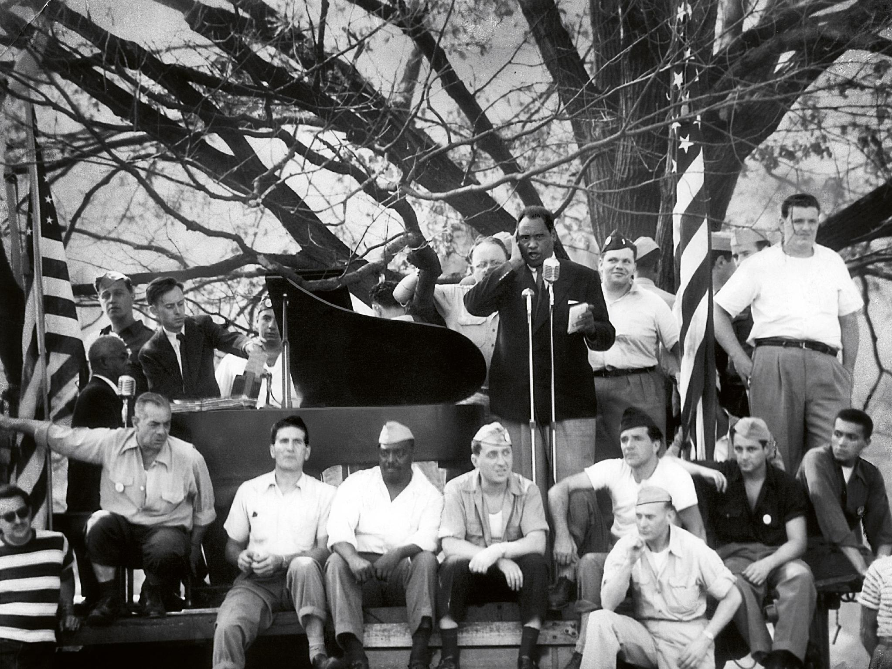
September 3, 1949, Guards

Slide 19
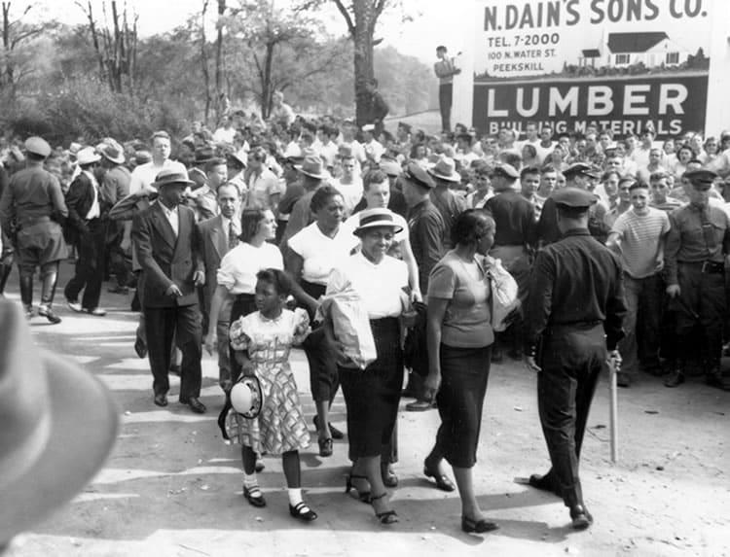

Slide 20
The Rapp-Coudert Committee
The committee operated from 1940 to 1942 and investigated alleged Communist influence at New York public colleges, especially CCNY. More than 500 faculty, staff, and students were subpoenaed.
The Rapp-Coudert investigations marked the beginning of the transition from the anti-fascist Popular Front era of the 1930s to the anti-communist repression that culminated in McCarthyism.
Among those fired were the labor historian Philip Foner.

Slide 21
Free Pass to Horrors of Capitalism by Democrats
the despicable condemnation of “the horrors of socialism,” by the U.S. House of Representatives, November 21, H.Con.Res. 58 — “Denouncing the horrors of socialism.”
“Full List of Democrats Voting to Condemn Socialism as Mamdani Comes to Town.” Newsweek, 21 Nov. 2025, https://www.newsweek.com/full-list-of-democrats-voting-to-condemn-socialism-as-mamdani-comes-to-town-11088383; This vote, especially by the 86 Democrats who supported it, including Hashim Jeffries, the Democratic Party House leader, certainly fits under the category of how shameless can one get. Such resolutions and claims have always been used functionally by reactionaries, especially in the U.S., to target, denounce, isolate, imprison, and murder those on the left, and even, those not so far left, like many of the Democrats who voted for the resolution.

Slide 22
No Mention of the Horrors of Capitalism
30-50 Millions died of famine caused by British Imperialists in India
20th century slaughter of 10+ million killed by Belgium in Congo
10s of millions of indigenous killed in Americas by colonial powers
Millions kidnapped from Africa by slave traders
10 million killed by Nazi Germany in death camps
- millions napalmed by U.S. in Vietnam
List goes on

Slide 23
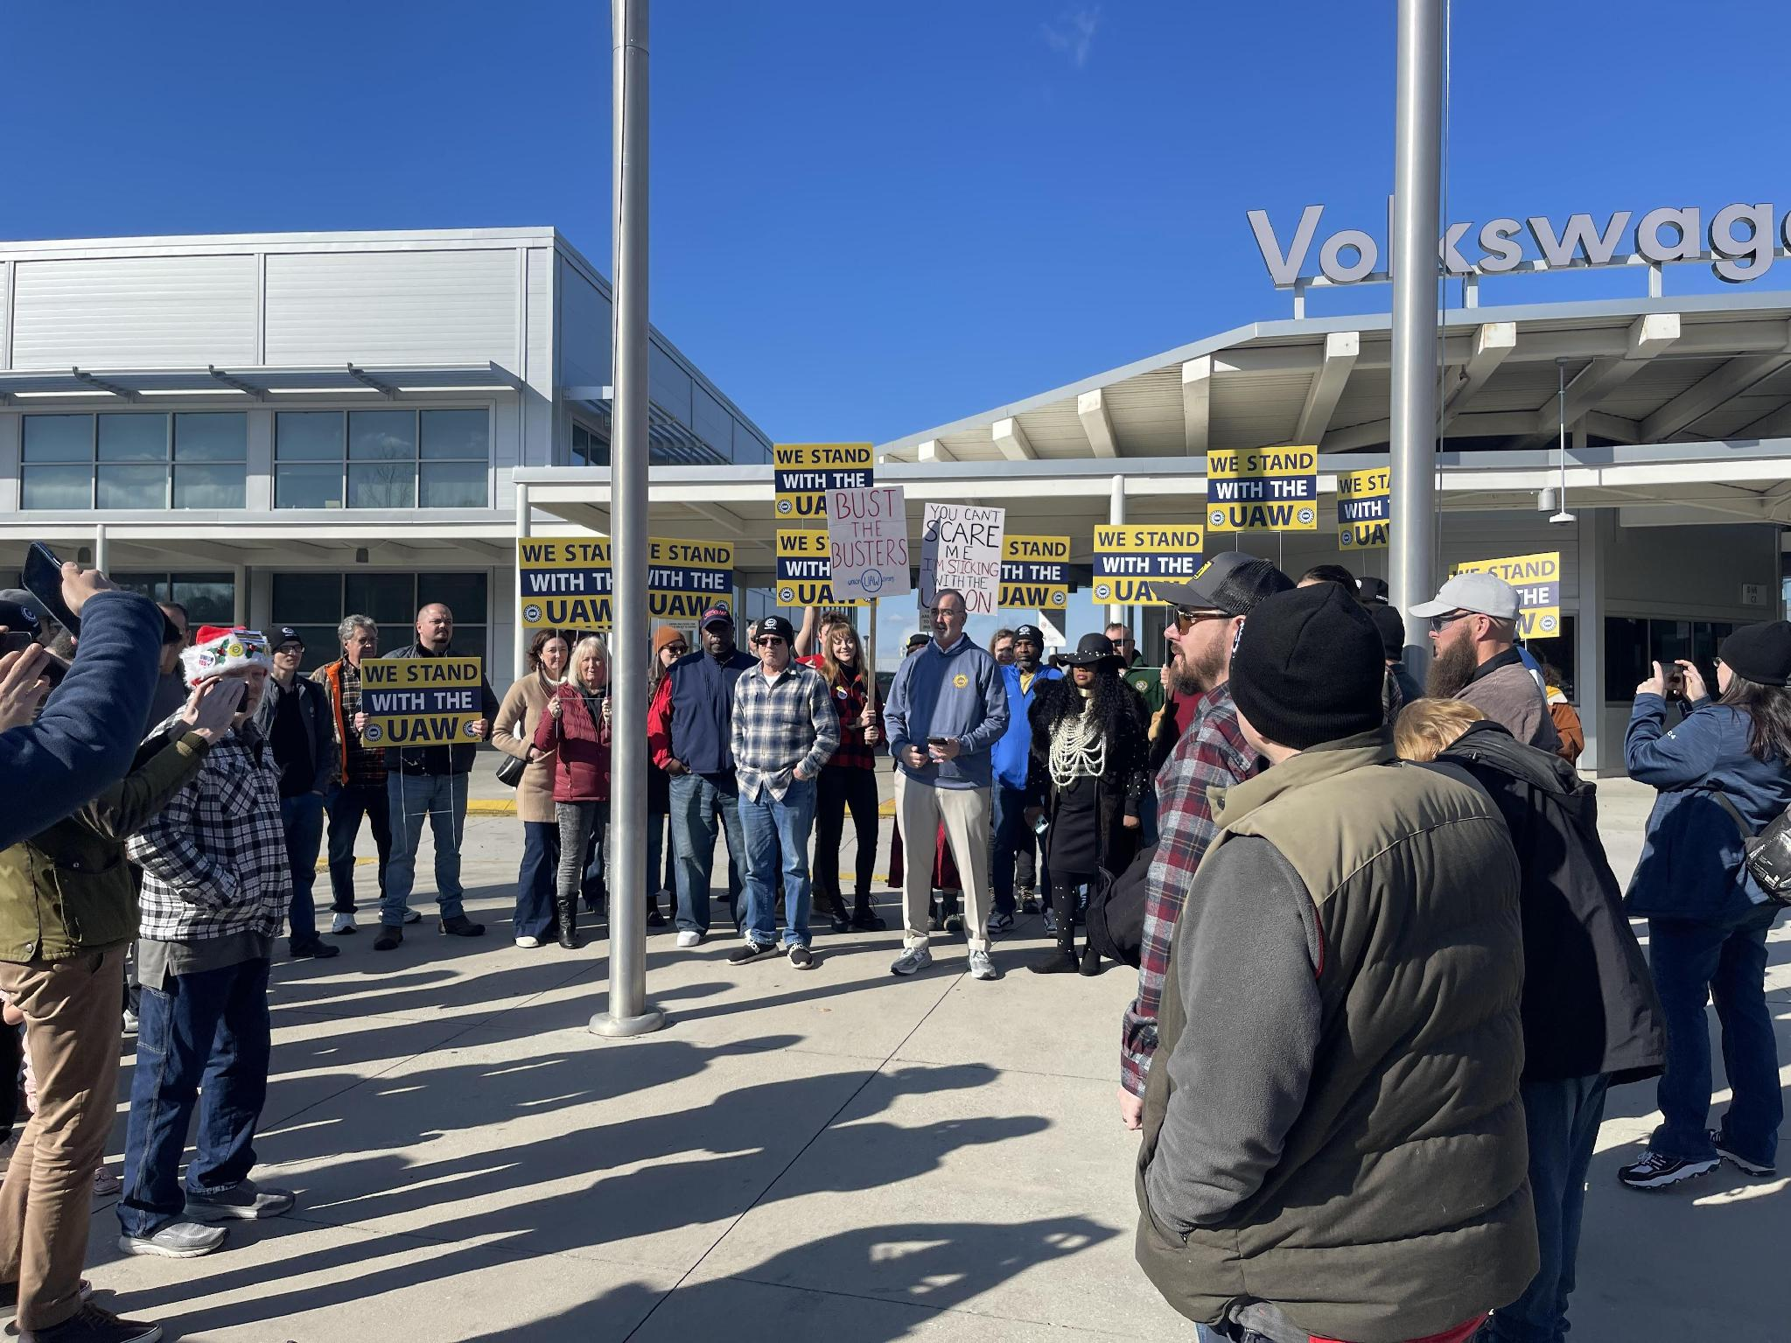
Chattanooga, TN

Slide 24
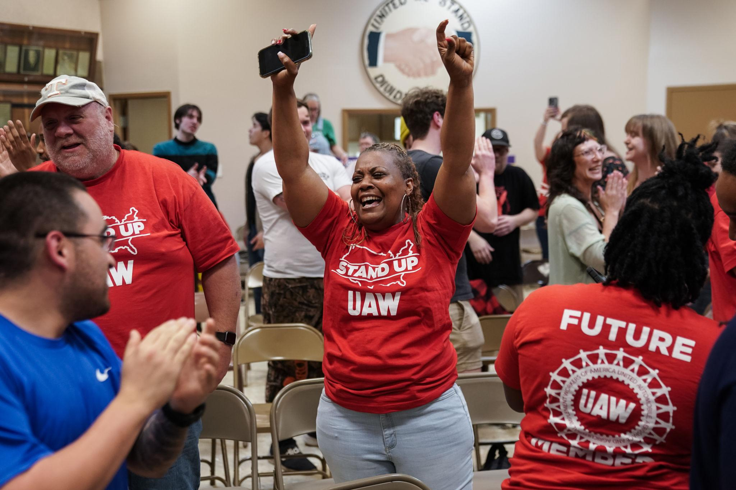
UAW Victory, 2024, 73% of Vote

Slide 25
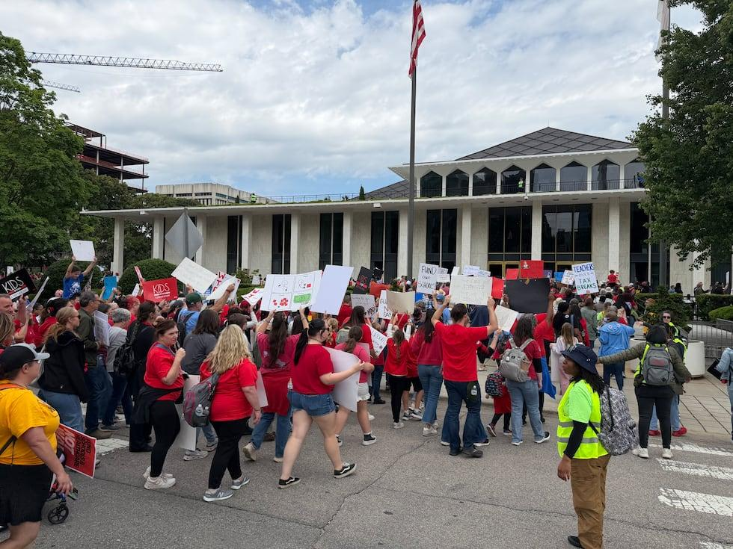
May Day, 2026, Charlotte, NC

Slide 26
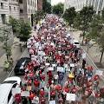
May Day, 2026, Raleigh, NC

Slide 27
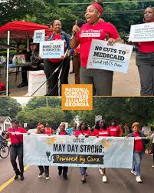
Narional Domestic Workers Alliance Georgia

Slide 28
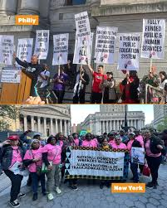
National Domestic Workers

Slide 29

Southern Workers Action Summit

Slide 30
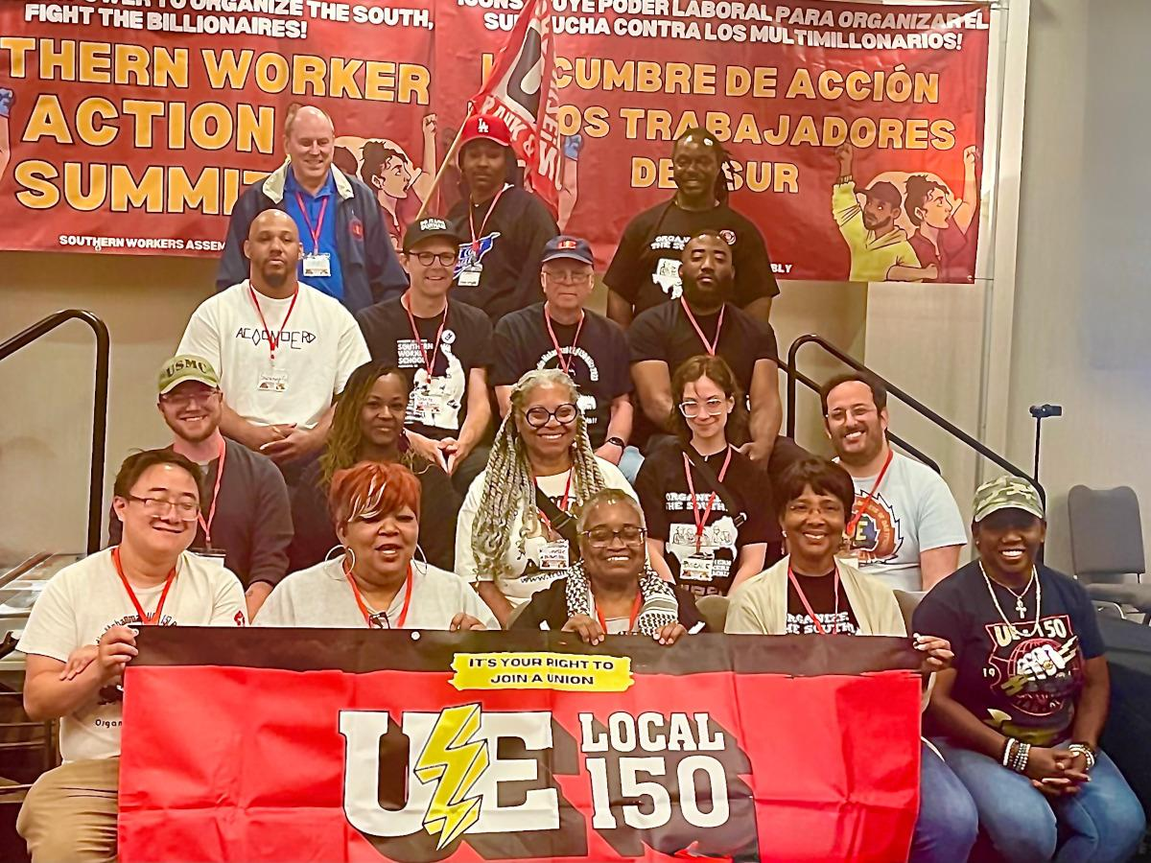

Slide 31
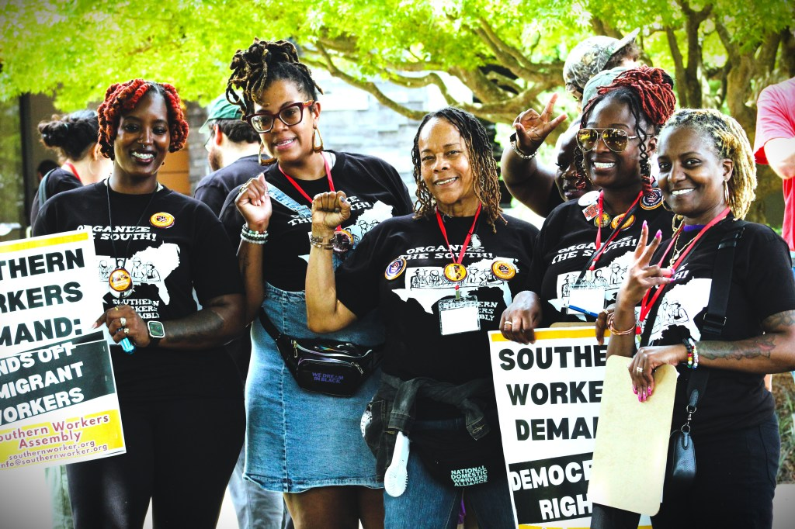

Slide 32
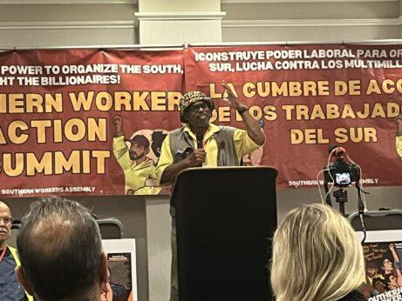

Slide 33
How are Reforms achieved Under Capitalism
1935 National Labor Relations (Wagner) Act
Passed as a result of mass strikes, led by revolutionary groups in 1934
1) Minneapolis Teamsters Strike, let by Trotskyists
2) San Francisco general strike, and coast wide longshore strike led by Harry Bridges and Communists
3) Toledo Auto-Lite Strike led by A.J. Muste and American Workers Party

Slide 34
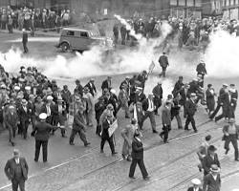
1934 Minneapolis teamsters strike mass picket line

Slide 35
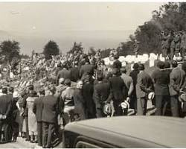
1934 San Francisco Funeral March for Slain Workers

Slide 36
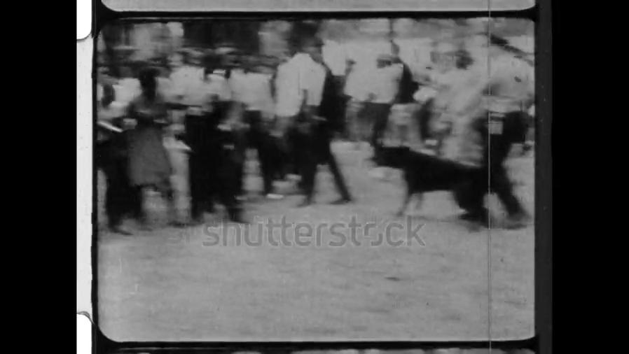
1964 Civil RightS Act
1965 Voting Rights Act
Notes:
Birmingham,. 1963

Slide 37
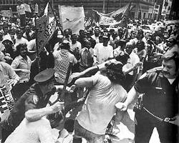
Coal Safety
1971 Occupational Safety and Health Act
1969 1970 West Virginia black lung strike mass rally of miners at state capitol

